Slide 1



Building the HCP Journeys
IBD Germany
Workshop #1
May 12, 2021

Slide 2
Introductions

Slide 3
HCP Journey Workshop Agenda - IBD
Attendees
Alexander, Jessika, Kathrin, Marc, Michael, Patrick
Alexandre/Gareth/Alex (Veeva)
Time | Topic | Format
3:30 – 3:40 | Team introductions | Roundtable
3:40 – 3:50 | Project Overview/What we want to achieve | Presentation
3:50 – 4:10 | Working session: Journey Framework - Events & Key Moments | Interactive Session
4:10 – 4:30 | Progress Sharing & Tool Demo | Presentation
4:30 – 5:15 | Working session Review and starting to iterate the local journeys | Breakout Session Groups
5:15 – 5:25 | Debrief & group discussion | Presentations back to the group
5:25 – 5:30 | Next steps

Slide 4


Workshop Roles
We are against the clock!
We only have a short amount of time together, lets be focused on having a super-efficient remote session.
Time-Keeper:
Let’s stay on-topic!
Everyone is very busy, and so keeping ‘on topic’ and always working towards the project outputs will be key.
‘Rabbit-Hole’ Monitor:

Slide 5
Project Overview

Slide 6

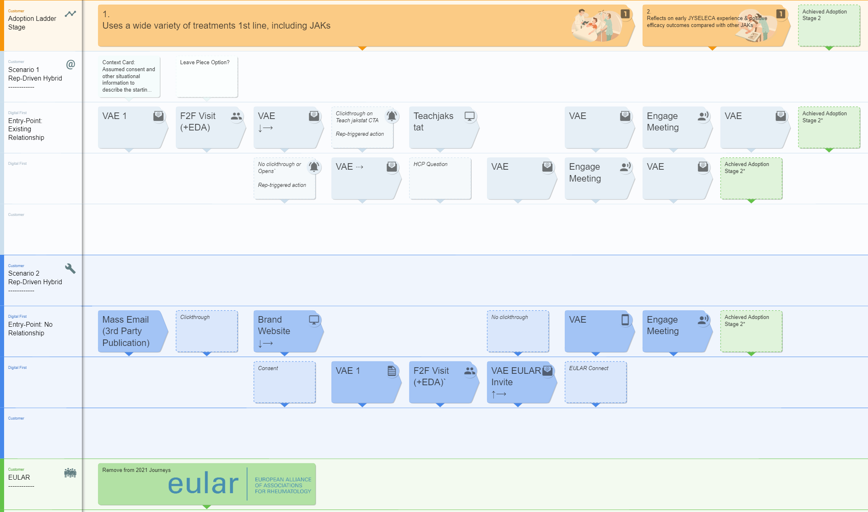
What is the HCP Journeys Project?
A cross functional team is now making strategy a reality, by creating HCP Journeys that bring together existing content, OC channels and research…
…into maps to guide the rapid movement of HCPs through stages in the adoption ladder.
Illustrative example

Slide 7

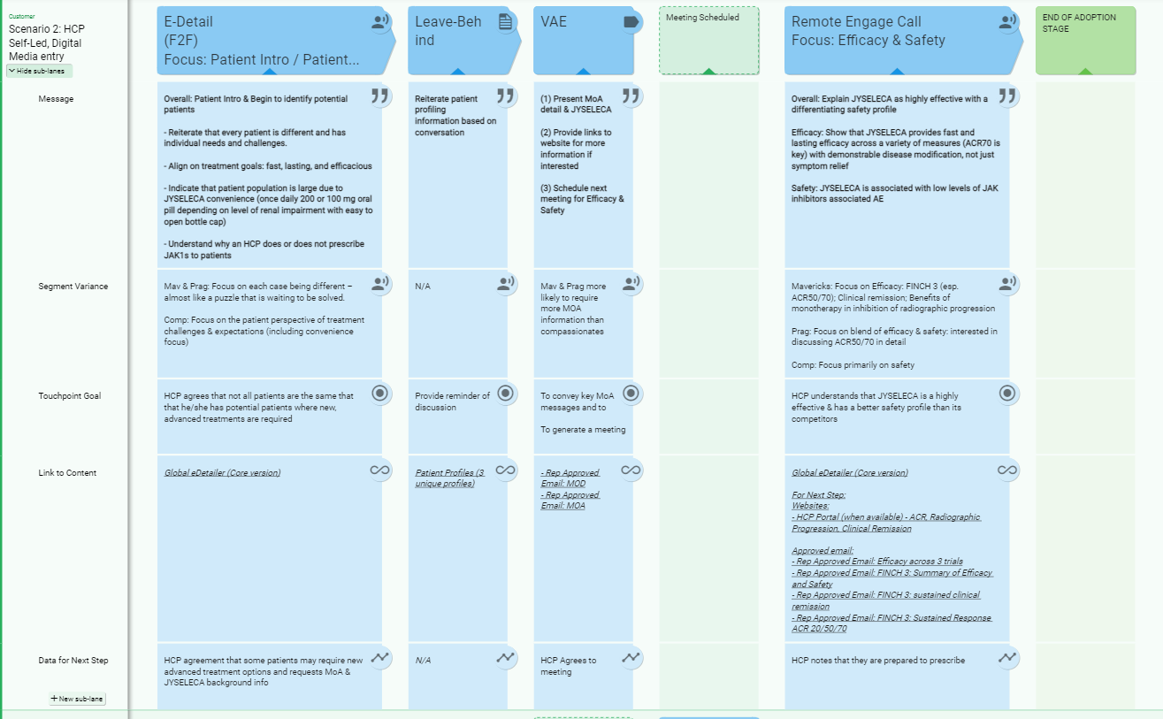
What will you get at the end?
A clear Customer Journey for your market, for the IBD indication, linked to driving HCPs up the initial stages in the adoption ladder
Journeys that are linked to content both existing and currently in production for launch, with easy access to the materials needed for execution (and view on planned content)
An easy-to-use Customer Journey format, to enable dynamic updates throughout the year

Slide 8
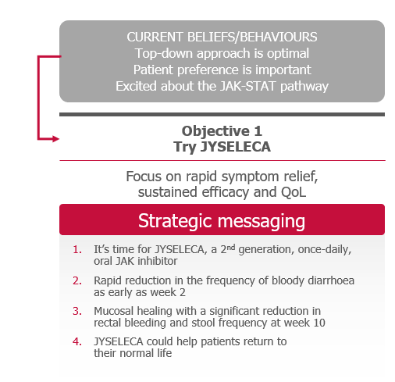
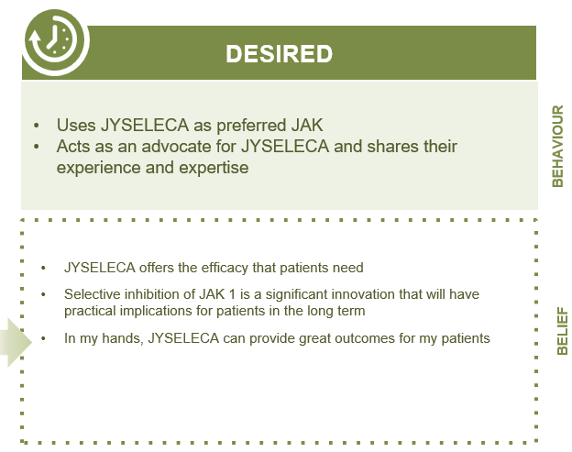
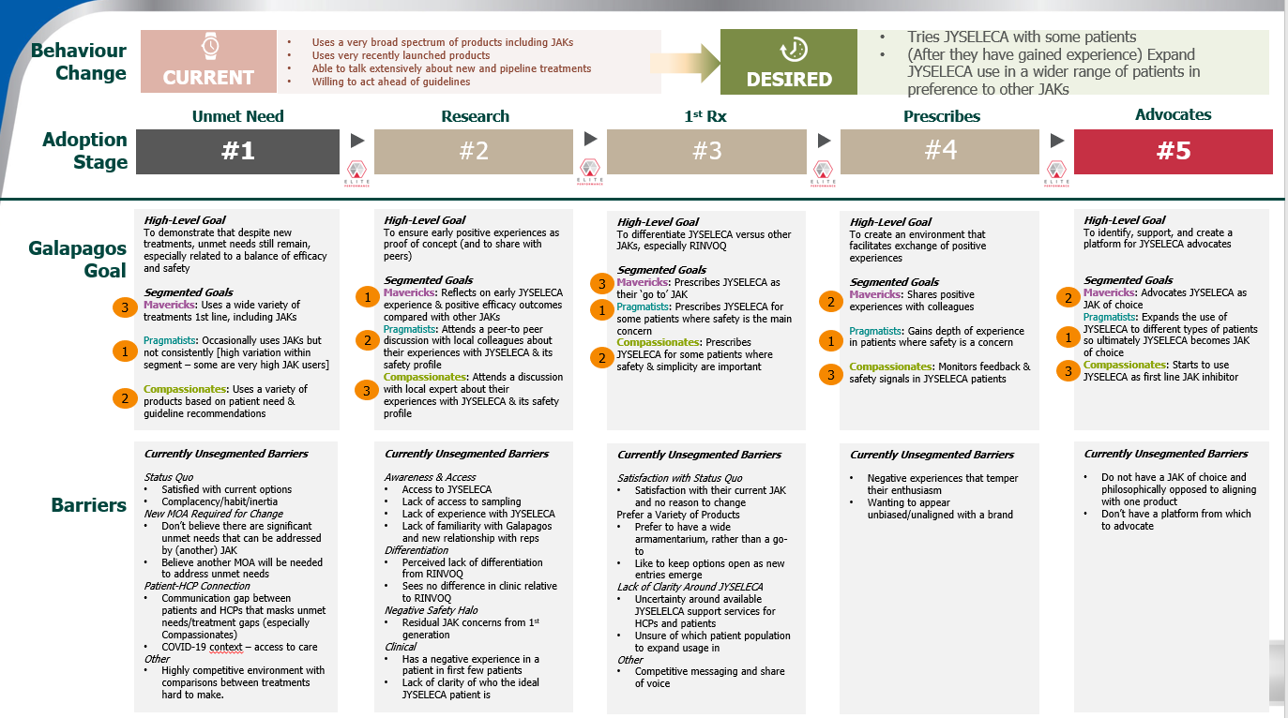
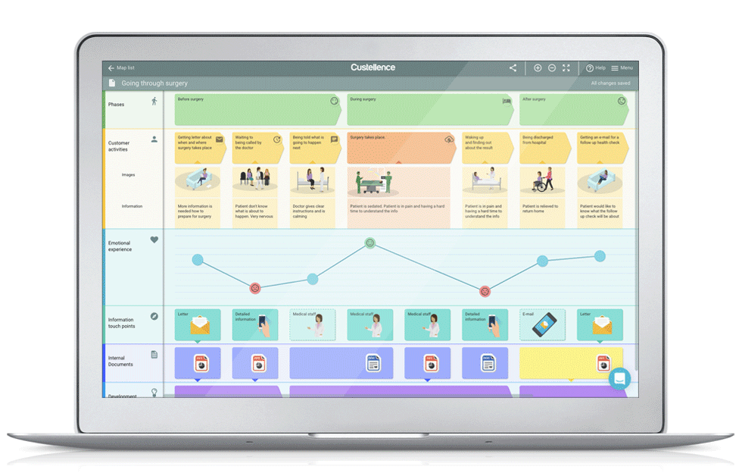



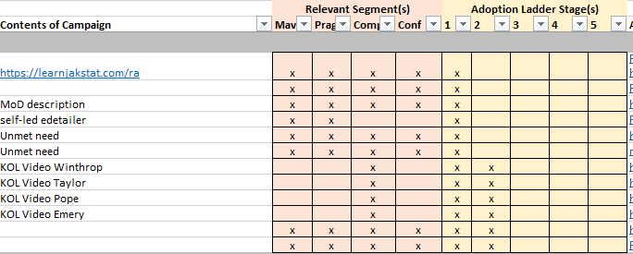

The Approach is Consistent & Cross-Functional
Brand / Strategy
Brand / Strategy
Marketing / Medical Maps
Leverage existing Strategy
Organise it for market clarity
Develop the Journeys
Research | Segmentation Channels | Content
The execution-focused mapping of the touchpoints with a HCP.
Adoption Ladder consolidation & consistent format
International illustrative Versions
IBD Segmentation
Content alignment to segmentation and adoption ladder stage
Localised executable Versions
Complete
In progress
In progress

Slide 9
How we are making this a reality
To reduce market workloads and to maximise outputs, we are working via a localisation model, with heavy support to markets between engagements.
March |  |  | April | April |  |  | May | May |  |  | June
15th | 22nd | 29th | 5th | 12th | 19th | 26th | 3rd | 10th | 17th | 24th | 31st | 7th | 14th | 21st
Leverage existing Strategy
Creation of consolidated, granular Adoption Ladder, to bring clarity to the brand strategy, research and segmentation
International Journey Creation
Creation of a set of scenario-driven customer journeys, to act as the template for localisation
Journey Localisation
Supported localisation of international Journeys
Brand - IBD
Germany (RA & IBD)
CI&E - OC
UK
workshops to occur- Sept’21
CI&E - SFE
IBD International Journeys currently in development
CRM & Technology
Smaller Markets
Shorter engagements with lighter localisation, leveraging both international and larger market Journeys. Workshop dates TBD
Market Research
Partner Agencies
3 x 2hr, cross functional market workshops.
With markets supported in the interim for the time-intensive activities
Today

Slide 10
Working Session - Framework

Slide 11

Customer Journey Framework
What are the framework elements that we should include in the journeys?

Slide 12




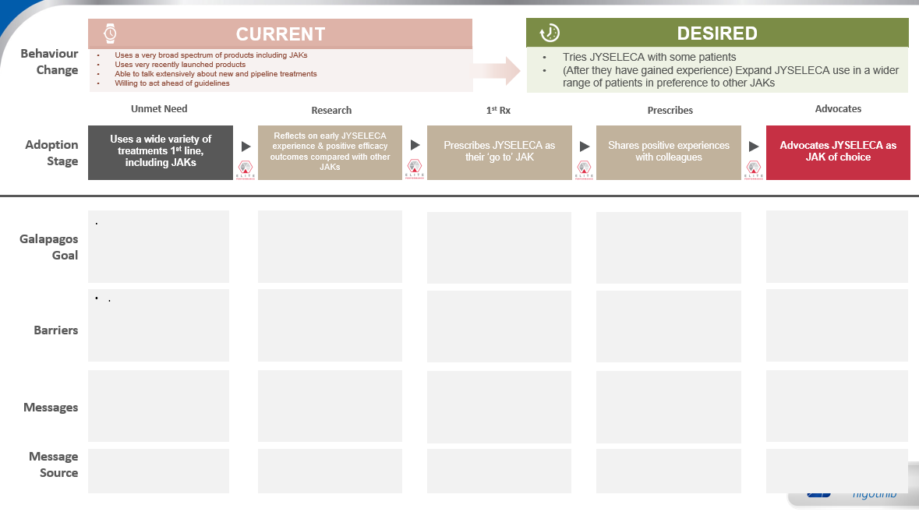

HCP Journey Components
In order to accelerate the creation of the journeys, in our experience it is valuable to first discuss the constituents of the Journeys.
Journey Scenarios
Segmentation
HCP Journeys
Behavioural Research
Key events
Adoption Ladder
Content & Channels
“Moments of Truth”

Slide 13


HCP Journey Scenarios
We can create HCP Journeys based on different categories or Scenarios, for example:
Field-Driven
HCP-Driven
Event-Driven
Rep and Medical journeys will be different, but they will work alongside each other.
(Medical have knowledge ladder)
Rep journeys – adoption ladder focused – route to Rx.
Multiple segmentation dimensions – priority, medical, commercial…
Flexible in how the targets are
Designed for the ‘core’ prescription target audience of Gis

Slide 14
As part of HCP Journeys, we need to ensure that we are incorporating the core local elements
1. Which are the Key Events we want to incorporate into the journeys?
(EULAR, Key Webinars etc)
2. What are the key ‘Milestones’ in the IBD Journey?
(First Prescription, Patient Identification etc)
Go to Slido.com
And enter the code: #IDEIBD

Slide 15

Decision
Which are the Key Events we want to incorporate ?
5 mins
Notes:
• World IBD Day (19.05.2021) - UC
• DDW (21.-23.05.2021) - UC
• EULAR (02.-05.06.2021) - RA
• Ecco (07.-10.07.2021) - UC
• DGVS (13.-18.09.2021) - UC
• DGRh (15.-18.09.2021) - RA
• JAKademie (01.-02.10.2021) - RA
• UEGW (03.-08.2021) - UC
• ACR (05.-09.11.2021) - RA

Slide 16
Decision
Which are the Milestones we want to consider ?
5 mins

Slide 17
Progress Sharing & Tool Demo

Slide 18




SCIENCE FIRST
(1 of 2)
Behaviour Change
CURRENT
Behaviour: Uses JAK inhibitors in 2nd/3rd line in a flexible approach. Persists within the same tx class.
Belief: Flexible approach is optimal. Mucosal healing & long-term remission are key treatment goals.
DESIRED
Behaviour: Uses 1st line in bio-naive. Uses JYSELECA as their advanced treatment of choice.
Belief: JYSELECA’s efficacy, safety and convenience data is comprehensive and differentiating. I will identify candidates to trial first line.
Current
Try JYSELECA
Expand Use
Use 2nd Line
Use 1st line in bio-naive
Adoption Stage
#1
#2
#3
#4
#5
Change behaviour from current 2nd/3rd line JAK inhibitor use to JYSELECA 1st line in bio-naive
Identify & trial JYSELECA in a patient who would benefit from a new mode of action and reassured by the mucosal healing & histologic remission achieved
Identify a wider pool of patients who are not adequately controlled & use JYSELECA to achieve mucosal healing & long-term results
Expand usage of JYSELECA as oral, that does not need steroid and provides the depth of sustained remission that they are looking for
Uses JYSELECA as their advanced treatment of choice
Galapagos Goal
Good options now
New MoAs are no more effective
Convenience is not driving long term remission
Barriers
Detailed in steps 2,3,4
Efficacy Messaging Objective: Focus on sustained remission including mucosal healing and CS-free remission
Detailed Messaging:
JYSELECA was evaluated in bio-naïve & bio-experienced patients with highly active disease
Demonstrated significant clinical and complete histologic remission at week 58
First therapy to meet ≥6-month CS-free clinical remission endpoint in a pivotal study
JYSELECA demonstrated significant mucosal healing at Week 58
JYSELECA is affective as monotherapy
Safety Messaging Objective: Highlight new MOA, demonstrated & consistent safety & tolerability profile
Detailed Messaging:
JYSELECA is a JAK1-preferential inhibitor with >5x potency for JAK1 over other JAK isoforms
Demonstrated safety and tolerability profile in UC studies
Low rates of special interest AEs
Low rates of serious AEs similar to placebo & low discontinuation rates (<5%)
Consistent safety profile across 7 studies in RA patients with over 5400 patient years of clinical exposure
Convenience Messaging Objective: Leverage the simplicity of oral ‘away from hospital’ treatment
Detailed Messaging:
JYSELECA is a simple once-daily 200-mg oral tablet
Same dose for induction and maintenance
Minimal monitoring
No immunogenicity and TDM
No infusions or injections
Limited need for hospital visits
Affirm positive experiences with JYSELECA and support use as advanced treatment of choice.
Identify potential advocates and influencers.
Messages
Message Source
Refer to Message Source Slide
Refer to Message Source Slide
Refer to Message Source Slide

Slide 19
SCIENCE FIRST
(2 of 2)
Behaviour Change
CURRENT
Behaviour: Uses JAK inhibitors in 2nd/3rd line in a flexible approach. Persists within the same tx class.
Belief: Flexible approach is optimal. Mucosal healing & long-term remission are key treatment goals.
DESIRED
Behaviour: Uses 1st line in bio-naive. Uses JYSELECA as their advanced treatment of choice.
Belief: JYSELECA’s efficacy, safety and convenience data is comprehensive and differentiating. I will identify candidates to trial first line.
Current
Try JYSELECA
Expand Use
Use 2nd Line
Use 1st line in bio-naive
Adoption Stage
#1
#2
#3
#4
#5
Messages
Efficacy Messaging Objective: Focus on sustained remission including mucosal healing and CS-free remission
Detailed Messaging:
JYSELECA was evaluated in bio-naïve & bio-experienced patients with highly active disease
Demonstrated significant clinical and complete histologic remission at week 58
First therapy to meet ≥6-month CS-free clinical remission endpoint in a pivotal study
JYSELECA demonstrated significant mucosal healing at Week 58
JYSELECA is affective as monotherapy
Safety Messaging Objective: Highlight new MOA, demonstrated & consistent safety & tolerability profile
Detailed Messaging:
JYSELECA is a JAK1-preferential inhibitor with >5x potency for JAK1 over other JAK isoforms
Demonstrated safety and tolerability profile in UC studies
Low rates of special interest AEs
Low rates of serious AEs similar to placebo & low discontinuation rates (<5%)
Consistent safety profile across 7 studies in RA patients with over 5400 patient years of clinical exposure
Convenience Messaging Objective: Leverage the simplicity of oral ‘away from hospital’ treatment
Detailed Messaging:
JYSELECA is a simple once-daily 200-mg oral tablet
Same dose for induction and maintenance
Minimal monitoring
No immunogenicity and TDM
No infusions or injections
Limited need for hospital visits
Affirm positive experiences with JYSELECA and support use as advanced treatment of choice.
Identify potential advocates and influencers.
Message Source / Channel
TS - eDA efficacy pages & leave behind
Email - SF 1 RTE 1
Media - SF 1 banner ad and email
Media – SF 1 journal ad
Web - JYSELECA HCP Portal
SF self-led DA
KOL SELECTION video
FAQ Podcasts
Conference - Exhibition Booth
Medical affairs activities
TS - eDA - MoA/safety pages & leave behind
Email - SF 2 RTE
Media - SF 2 banner ad and email
Media - SF 2 journal ad
Web - JYSELECA HCP Portal
SGF self-led DA
MoA video
FAQ Podcasts
Conference - Exhibition Booth
Medical affairs activities
TS - eDA - convenience pages & leave behind
TS - Patient brochure
Email - SF 3 RTE
Media - SF 3 banner ad and email
Media - SF 3 journal ad
Web - JYSELECA HCP portal
SF self-led DA
Real life patient cases
Conference – Exhibition Booth
Medical affairs activities

Slide 20
Custellence
After comparing a multitude of tools, we believe Custellence has the best balance of features vs simplicity, with simplicity being key.
Custellence is a simple, 1-page journey creation tool, with collaboration functionality.
We are using Custellence solely to help guide the creation of HCP Journeys, not for use in the orchestration or execution of journeys.

Slide 21
The Tool – Live Demo

Slide 22
Working Session - Custellence®

Slide 23
Customer Journey Using Custellence®
How can we refine and complete the customer journeys?

Slide 24
Debrief

Slide 25
Next Steps

Slide 26
Following Today’s Session
Action | Who | When
Continue build of HCP Journeys following lessons learned & outcomes of today’s session | Veeva
Review Adoption Ladder Template for relevance in German market | German Team

Slide 27
Appendix

Slide 28
Pre-Launch Behaviour Change Scale
Non-segmented and Modeled on Science First

Slide 29
SCIENCE FIRST
Behaviour Change
CURRENT
Behaviour: Uses JAK inhibitors in 2nd/3rd line in a flexible approach.
Belief: Flexible approach is optimal.. Additional effective/safe options needed. New MoAs are proving themselves.
DESIRED
Behaviour: Open to trial new rigorously studied JAK-preferential inhibitors.
Belief: Optimistic about the pipeline. Looking forward to new MoAs.
Current
MoA Revolution
Preferential Approach
Unmet Tx Needs
Identify Patients
Adoption Stage
#1
#2
#3
#4
#5
Encourage confident problem-solvers who have a flexible approach to UC treatment to include JAK1-preferential MoA in their treatment paradigm thinking.
Establish that various cytokines, signalling pathways and particularly the JAK-STAT pathway are of therapeutic interest in UC.
Increase focus on JAK-1 containing pairs in the JAK-STAT pathway and the difference between PAN-JAK and JAK-preferential approaches.
Establish need for proven MoAs that deliver sustained clinical remission & mucosal healing when UC has not responded/stopped responding to therapy.
Open to try new rigorously studied JAK inhibitors when available
Galapagos Goal
Good options now
New MoAs are no more effective
Potential access challenges
Barriers
Detailed in steps 2,3,4
MoA Messaging Objective: Establish importance of the JAK-STAT pathway in UC pathogenesis
Detailed Messaging:
Various cytokines, signalling pathways and particularly the JAK-STAT pathway are of therapeutic interest in UC
The JAK-STAT pathway, comprising 4 JAK proteins, mediates both pro-inflammatory and normal physiological functions
The pathway represents a point of convergence common to multiple pathways of inflammation that becomes deregulated in the excessive inflammatory signalling of UC
Preferential Messaging Objective: Highlight differences between PAN-JAK and JAK1-preferential approaches Detailed Messaging:
Many pro-inflammatory cytokines implicated in UC signal through JAK1-containing pairs
JAK2 is largely restricted to cells that are important for normal blood cell production
JAK3 is expressed in haematopoietic cells and plays a key role in the development of immune cells
A preferential focus on JAK1 may be key to impact UC-associated inflammation while preserving normal physiologic activity
Unmet Needs Messaging Objective: Explore unmet treatment needs and benefits of early intervention
Detailed Messaging:
There is an unmet need for additional efficacious, simple, and well-tolerated therapies with novel MoAs
Rapid, sustained, and early control of inflammation has the potential to improve disease course in patients with UC
Sustained control of inflammation delivers clinical remission that should be corticosteroid-free and confirmed with endoscopic and ultimately histologic findings
Think about patients who have relapsed on current therapy and could benefit from a new MoA with a less complex treatment regimen.
Messages
Message Source
Refer to Message Source Slide
Refer to Message Source Slide
Refer to Message Source Slide

Slide 30
SCIENCE FIRST
Behaviour Change
CURRENT
Behaviour: Uses JAK inhibitors in 2nd/3rd line in a flexible approach.
Belief: Flexible approach is optimal.. Additional effective/safe options needed. New MoAs are proving themselves.
DESIRED
Behaviour: Open to trial new rigorously studied JAK-preferential inhibitors.
Belief: Optimistic about the pipeline. Looking forward to new MoAs.
Current
MoA Revolution
Preferential Approach
Unmet TX Needs
Identify Patients
Adoption Stage
#1
#2
#3
#4
#5
Messages
MoA Messaging Objective: Establish importance of the JAK-STAT pathway in UC pathogenesis
Detailed Messaging:
Various cytokines, signalling pathways and particularly the JAK-STAT pathway are of therapeutic interest in UC
The JAK-STAT pathway, comprising 4 JAK proteins, mediates both pro-inflammatory and normal physiological functions
The pathway represents a point of convergence common to multiple pathways of inflammation that becomes deregulated in the excessive inflammatory signalling of UC
Preferential Messaging Objective: Highlight differences between PAN-JAK and JAK1-preferential approaches Detailed Messaging:
Many pro-inflammatory cytokines implicated in UC signal through JAK1-containing pairs
JAK2 is largely restricted to cells that are important for normal blood cell production
JAK3 is expressed in haematopoietic cells and plays a key role in the development of immune cells
A preferential focus on JAK1 may be key to impact UC-associated inflammation while preserving normal physiologic activity
Unmet Needs Messaging Objective: Explore unmet treatment needs and benefits of early intervention
Detailed Messaging:
There is an unmet need for additional efficacious, simple, and well-tolerated therapies with novel MoAs
Rapid, sustained, and early control of inflammation has the potential to improve disease course in patients with UC
Sustained control of inflammation delivers clinical remission that should be corticosteroid-free and confirmed with endoscopic and ultimately histologic findings
Think about patients who have relapsed on current therapy and could benefit from a new MoA with a less complex treatment regimen.
Message Source / Channel
FF - MoD pages in ‘Discussion Guide’ & TFJS/GH leave behind
Email 2 - MoA revolution
Media - MoD banner ad, email & journal ad
Web - JAK-STAT pages, MoD video, ‘Emerging Therapies Talking Head video’ & self-led DA
Web - MoD quiz questions
Conference - Exhibition Booth
Medical affairs activities
FF – MoD pages in ‘Discussion Guide’& T4JS/GH leave behind
Email 4 – What’s new in UC
Media - MoD banner ad, email & journal ad
Web - JAK-STAT pages, MoD video, ‘Emerging Therapies Talking Head video’ & self-led DA
Conference – Exhibition Booth
Medical affairs activities
FF - unmet needs pages in ‘Discussion Guide’ & TFJS/GH leave behind
Email 3 – Unmet needs in UC
Media – unmet needs banner ad, email & journal ad
Web - unmet needs pages & unmet needs video
Web - unmet needs quiz questions & self-led DA
Conference – Exhibition Booth
Medical affairs activities

Slide 31
Post-Launch Adoption Ladders
By Segment

Slide 32
SCIENCE FIRST
Behaviour Change
CURRENT
Behaviour: Uses JAK inhibitors in 2nd/3rd line in a flexible approach. Persists within the same tx class.
Belief: Flexible approach is optimal. Mucosal healing & long-term remission are key treatment goals.
DESIRED
Behaviour: Uses 1st line in bio-naive. Uses JYSELECA as their advanced treatment of choice.
Belief: JYSELECA’s efficacy, safety and convenience data is comprehensive and differentiating. I will identify candidates to trial first line.
Current
Try JYSELECA
Expand Use
Use 2nd Line
Use 1st line in bio-naive
Adoption Stage
#1
#2
#3
#4
#5
Change behaviour from current 2nd/3rd line JAK inhibitor use to JYSELECA 1st line in bio-naive
Identify & trial JYSELECA in a patient who would benefit from a new mode of action and reassured by the mucosal healing & histologic remission achieved
Identify a wider pool of patients who are not adequately controlled & use JYSELECA to achieve mucosal healing & long-term results
Expand usage of JYSELECA as oral, that does not need steroid and provides the depth of sustained remission that they are looking for
Uses JYSELECA as their advanced treatment of choice
Galapagos Goal
Good options now
New MoAs are no more effective
Convenience is not driving long term remission
Barriers
Detailed in steps 2,3,4
Efficacy Messaging Objective: Focus on sustained remission including mucosal healing and CS-free remission
Detailed Messaging:
JYSELECA was evaluated in bio-naïve & bio-experienced patients with highly active disease
Demonstrated significant clinical and complete histologic remission at week 58
First therapy to meet ≥6-month CS-free clinical remission endpoint in a pivotal study
JYSELECA demonstrated significant mucosal healing at Week 58
JYSELECA is affective as monotherapy
Safety Messaging Objective: Highlight new MOA, demonstrated & consistent safety & tolerability profile
Detailed Messaging:
JYSELECA is a JAK1-preferential inhibitor with >5x potency for JAK1 over other JAK isoforms
Demonstrated safety and tolerability profile in UC studies
Low rates of special interest AEs
Low rates of serious AEs similar to placebo & low discontinuation rates (<5%)
Consistent safety profile across 7 studies in RA patients with over 5400 patient years of clinical exposure
Convenience Messaging Objective: Leverage the simplicity of oral ‘away from hospital’ treatment
Detailed Messaging:
JYSELECA is a simple once-daily 200-mg oral tablet
Same dose for induction and maintenance
Minimal monitoring
No immunogenicity and TDM
No infusions or injections
Limited need for hospital visits
Affirm positive experiences with JYSELECA and support use as advanced treatment of choice.
Identify potential advocates and influencers.
Messages
Message Source
Refer to Message Source Slide
Refer to Message Source Slide
Refer to Message Source Slide

Slide 33
SCIENCE FIRST
Behaviour Change
CURRENT
Behaviour: Uses JAK inhibitors in 2nd/3rd line in a flexible approach. Persists within the same tx class.
Belief: Flexible approach is optimal. Mucosal healing & long-term remission are key treatment goals.
DESIRED
Behaviour: Uses 1st line in bio-naive. Uses JYSELECA as their advanced treatment of choice.
Belief: JYSELECA’s efficacy, safety and convenience data is comprehensive and differentiating. I will identify candidates to trial first line.
Current
Try JYSELECA
Expand Use
Use 2nd Line
Use 1st line in bio-naive
Adoption Stage
#1
#2
#3
#4
#5
Messages
Efficacy Messaging Objective: vv
Detailed Messaging:
JYSELECA was evaluated in bio-naïve & bio-experienced patients with highly active disease
Demonstrated significant clinical and complete histologic remission at week 58
First therapy to meet ≥6-month CS-free clinical remission endpoint in a pivotal study
JYSELECA demonstrated significant mucosal healing at Week 58
JYSELECA is affective as monotherapy
Safety Messaging Objective: Highlight new MOA, demonstrated & consistent safety & tolerability profile
Detailed Messaging:
JYSELECA is a JAK1-preferential inhibitor with >5x potency for JAK1 over other JAK isoforms
Demonstrated safety and tolerability profile in UC studies
Low rates of special interest AEs
Low rates of serious AEs similar to placebo & low discontinuation rates (<5%)
Consistent safety profile across 7 studies in RA patients with over 5400 patient years of clinical exposure
Convenience Messaging Objective: Leverage the simplicity of oral ‘away from hospital’ treatment
Detailed Messaging:
JYSELECA is a simple once-daily 200-mg oral tablet
Same dose for induction and maintenance
Minimal monitoring
No immunogenicity and TDM
No infusions or injections
Limited need for hospital visits
Affirm positive experiences with JYSELECA and support use as advanced treatment of choice.
Identify potential advocates and influencers.
Message Source / Channel
TS - eDA efficacy pages & leave behind
Email - SF 1 RTE 1
Media - SF 1 banner ad and email
Media – SF 1 journal ad
Web - JYSELECA HCP Portal
SF self-led DA
KOL SELECTION video
FAQ Podcasts
Conference - Exhibition Booth
Medical affairs activities
TS - eDA - MoA/safety pages & leave behind
Email - SF 2 RTE
Media - SF 2 banner ad and email
Media - SF 2 journal ad
Web - JYSELECA HCP Portal
SGF self-led DA
MoA video
FAQ Podcasts
Conference - Exhibition Booth
Medical affairs activities
TS - eDA - convenience pages & leave behind
TS - Patient brochure
Email - SF 3 RTE
Media - SF 3 banner ad and email
Media - SF 3 journal ad
Web - JYSELECA HCP portal
SF self-led DA
Real life patient cases
Conference – Exhibition Booth
Medical affairs activities

Slide 34
PATIENT FIRST
Behaviour Change
CURRENT
Behaviour: Use JAKs for a limited number of patients and use steroids for quick symptom relief & QoL.
Belief: Top-down approach is optimal. Patient preference is important. Excited about the JAK-STAT pathway.
DESIRED
Behaviour: Use 1st line in bio-naïve. Uses JYSELECA as their advanced treatment of choice.
Belief: I am confident that JYSELECA is the right solution b/c of efficacy/safety and convenience. I have candidates to trial JYSELECA first-line.
Current
Try JYSELECA
Ask all Patients
Use 2nd Line
Use 1st line in bio-naive
Adoption Stage
#1
#2
#3
#4
#5
Change behaviour from current limited 1st line JAK inhibitor use to JYSELECA as their advanced treatment of choice
Identify & trial JYSELECA to achieve rapid control & symptom relief for a patient who is struggling with their symptoms & burden of treatment
Ask all patients (naïve/ exp) whether they would prefer an oral treatment providing rapid efficacy & the safety profile that the patient needs
Choose JYSELECA as standard of care oral after first biologic failure as the most simple & convenient solution for their patient
Uses JYSELECA as their advanced treatment of choice
Galapagos Goal
Use of steroids
Convenience as one driver for treatment choice
Safety concerns with some therapies
Barriers
Detailed in steps 2,3,4
Efficacy Messaging Objective: Focus on rapid symptom relief, sustained efficacy and QoL improvements
Detailed Messaging:
It’s time for JYSELECA, a 2nd generation, once-daily, oral JAK inhibitor
Rapid reduction in the frequency of bloody diarrhea as early as week 2
Mucosal healing with a significant reduction in rectal bleeding and stool frequency at week 10
JYSELECA could help patients return to their normal lives
Convenience Messaging Objective: Highlight simplicity for the patient that is above and beyond once-daily oral
Detailed Messaging:
Side effects/therapeutic drug monitoring & parenteral/sub-cutaneous administration are factors contributing to the burden of UC treatment for some patients
JYSELECA is a simple once-daily 200-mg oral tablet
Same dose for induction and maintenance
Minimal monitoring
No immunogenicity and TDM
Safety Messaging Objective: Address any potential safety concerns and be reassured of the simple choice
Detailed Messaging
JYSELECA is a JAK1-preferential inhibitor with >5x potency for JAK1 over other JAK isoforms
Demonstrated safety and tolerability profile in UC studies
Low rates of special interest Aes
Low rates of serious AEs similar to placebo & low discontinuation rates (<5%)
Jyseleca is the simple solution for you and your patients
Affirm positive experiences with JYSELECA and support use as advanced treatment of choice.
Identify potential advocates and influencers.
Messages
Message Source
Refer to Asset Overview Slide
Refer to Asset Overview Slide
Refer to Asset Overview Slide
Refer to Asset Overview Slide
Refer to Asset Overview Slide

Slide 35
PATIENT FIRST
Behaviour Change
CURRENT
Behaviour: Use JAKs for a limited number of patients and use steroids for quick symptom relief & QoL.
Belief: Top-down approach is optimal. Patient preference is important. Excited about the JAK-STAT pathway.
DESIRED
Behaviour: Use 1st line in bio-naïve. Uses JYSELECA as their advanced treatment of choice.
Belief: I am confident that JYSELECA is the right solution b/c of efficacy/safety and convenience. I have candidates to trial JYSELECA first-line.
Current
Try JYSELECA
Ask all Patients
Use 2nd Line
Use 1st line in bio-naive
Adoption Stage
#1
#2
#3
#4
#5
Messages
Efficacy Messaging Objective: Focus on rapid symptom relief, sustained efficacy and QoL improvements
Detailed Messaging:
It’s time for JYSELECA, a 2nd generation, once-daily, oral JAK inhibitor
Rapid reduction in the frequency of bloody diarrhea as early as week 2
Mucosal healing with a significant reduction in rectal bleeding and stool frequency at week 10
JYSELECA could help patients return to their normal lives
Convenience Messaging Objective: Highlight simplicity for the patient that is above and beyond once-daily oral
Detailed Messaging:
Side effects/therapeutic drug monitoring & parenteral/sub-cutaneous administration are factors contributing to the burden of UC treatment for some patients
JYSELECA is a simple once-daily 200-mg oral tablet
Same dose for induction and maintenance
Minimal monitoring
No immunogenicity and TDM
Safety Messaging Objective: Address any potential safety concerns and be reassured of the simple choice
Detailed Messaging
JYSELECA is a JAK1-preferential inhibitor with >5x potency for JAK1 over other JAK isoforms
Demonstrated safety and tolerability profile in UC studies
Low rates of special interest Aes
Low rates of serious AEs similar to placebo & low discontinuation rates (<5%)
Jyseleca is the simple solution for you and your patients
Affirm positive experiences with JYSELECA and support use as advanced treatment of choice.
Identify potential advocates and influencers.
Message Source / Channel
TS - eDA efficacy pages & leave behind
Email - PF 1 RTE
Media - PF 1 banner ad and email
Media - PF 1 journal ad
Web - JYSELECA HCP Portal
PF self-led DA
FAQ Podcasts
Real life patient cases (bio-naïve)
Conference - Exhibition Booth
Medical affairs activities
TS - eDA convenience pages & leave behind
Email - PF 2 RTE
Media - PF 2 banner ad and email
Media - PF 2 journal ad
Web - JYSELECA HCP Portal
PF self-led DA
Patient brochure
Real life patient cases (bio-naïve)
Conference - Exhibition Booth
Medical affairs activities
TS – eDA safety pages & leave behind
Email – PF 3 RTE
Media – PF 3 banner ad and email
Media – PF 3 journal ad
Web – JYSELECA HCP Portal
PF self-led DA
MOA video
RMM
FAQ Podcasts
Real life patient cases
Conference - Exhibition Booth
Medical affairs activities

Slide 36
FAMILIARITY FIRST
Behaviour Change
CURRENT
Behaviour: Use a cautious step-up approach & very rare use of JAKs.
Belief: Cautious step-up approach gives confidence. Current therapies work for most patients. New MoAs are worth considering.
DESIRED
Behaviour: Use 2nd Line - start to use JYSELECA as first option after 1st biologic failure based on the positive feedback they have received from patients.
Belief: Experts are recommending new MoAs. JYSELECA is a simple & safe new option. Considering after 1st biologic failure.
Current
Discuss JYSELECA
Trial JYSELECA in 3rd Line
Expand Use
Use 2nd Line
Adoption Stage
#1
#2
#3
#4
#5
Change current behaviour from a cautious step-up approach with very rare use of JAKs to a more flexible top-down approach with JYSELECA after 1st biologic failure
Open to discuss JYSELECA as a safe & simple option in their treatment paradigm
Trial JYSELECA in a 3rd line treatment based on peer-feedback reassuring on the safety profile – develop a case study on this patient
Expand use of JYSELECA in 3rd line – tried and tested based on their own experience
Start to use JYSELECA as the first option after 1st biologic failure based on the positive feedback they have received from their patients
Galapagos Goal
Satisfied with current therapies
Anti-TNFs effective & safe
Safety concern about Jak Class
Barriers
Detailed in 2,3,4
Benefits Messaging Objective: Focus on sustained remission and safety in bio-experienced
Detailed Messaging:
Experts are recommending rapid introduction of advanced therapies to improve patient outcomes in moderate-to-severe UC
Demonstrated significant clinical remission at week 58
First therapy to meet ≥6-month CS-free clinical remission endpoint in a pivotal study
Favourable safety and tolerability profile in UC studies
Consistent safety profile across 7 studies in RA patients with over 5400 patient years of clinical exposure
Safety Messaging Objective: Address potential safety concerns by leveraging preferential MOA
Detailed Messaging:
It’s time to consider JYSELECA, a 2nd generation, once-daily, oral JAK inhibitor
Demonstrated safety and tolerability profile in UC studies
Low rates of special interest AEs
Low rates of serious AEs similar to placebo & llow discontinuation rates (<5%)
JYSELECA demonstrated significant mucosal healing at week 58
Convenience Messaging Objective: Highlight simplicity for the patient and no immunogenicity
Detailed Messaging
JYSELECA is a simple once-daily 200-mg oral tablet
No immunogenicity and TDM
Same dose for induction and maintenance
Minimal monitoring
JYSELECA could help patients return to their normal lives
Affirm positive experiences with JYSELECA and support use as 2L advanced treatment of choice.
Messages
Message Source
Refer to Asset Overview Slide
Refer to Asset Overview Slide
Refer to Asset Overview Slide
Refer to Asset Overview Slide
Refer to Asset Overview Slide

Slide 37
FAMILIARITY FIRST
Behaviour Change
CURRENT
Behaviour: Use a cautious step-up approach & very rare use of JAKs.
Belief: Cautious step-up approach gives confidence. Current therapies work for most patients. New MoAs are worth considering.
DESIRED
Behaviour: Use 2nd Line - start to use JYSELECA as first option after 1st biologic failure based on the positive feedback they have received from patients
Belief: Experts are recommending new MoAs. JYSELECA is a simple & safe new option. Considering after 1st biologic failure.
Current
Discuss JYSELECA
Trial JYSELECA in 3rd Line
Expand Use
Use 2nd Line
Adoption Stage
#1
#2
#3
#4
#5
Messages
Benefits Messaging Objective: Focus on sustained remission and safety in bio-experienced
Detailed Messaging:
Experts are recommending rapid introduction of advanced therapies to improve patient outcomes in moderate-to-severe UC
Demonstrated significant clinical remission at week 58
First therapy to meet ≥6-month CS-free clinical remission endpoint in a pivotal study
Favourable safety and tolerability profile in UC studies
Consistent safety profile across 7 studies in RA patients with over 5400 patient years of clinical exposure
Safety Messaging Objective: Address potential safety concerns by leveraging preferential MOA
Detailed Messaging:
It’s time to consider JYSELECA, a 2nd generation, once-daily, oral JAK inhibitor
Demonstrated safety and tolerability profile in UC studies
Low rates of special interest AEs
Low rates of serious AEs similar to placebo & llow discontinuation rates (<5%)
JYSELECA demonstrated significant mucosal healing at week 58
Convenience Messaging Objective: Highlight simplicity for the patient and no immunogenicity
Detailed Messaging
JYSELECA is a simple once-daily 200-mg oral tablet
No immunogenicity and TDM
Same dose for induction and maintenance
Minimal monitoring
JYSELECA could help patients return to their normal lives
Affirm positive experiences with JYSELECA and support use as 2L advanced treatment of choice.
Message Source / Channel
TS - eDA - unmet needs and efficacy/safety benefit pages & leave behind
Email - FF 1 RTE
Media - FF 1 email and banner ad
Media - FF 1 journal ad
Web - JYSELECA HCP Portal
FF self-led DA
FAQ Podcasts
Conference - Exhibition Booth
Medical affairs activities
TS - eDA - safety benefits pages & leave behind
Email - FF 2 RTE
Media - FF 2 email and banner ad
Media - FF 2 journal ad
Web - JYSELECA HCP Portal
FF self-led DA
FAQ Podcasts
Real life patient cases (bio-experienced)
Conference - Exhibition Booth
Medical affairs activities
TS - eDA - convenience and safety pages & leave behind
TS - patient brochure
Email - FF 3 RTE
Media - FF 3 email and banner ad
Media - FF 3 journal ad
Web - JYSELECA HCP Portal
FF self-led DA
FAQ Podcasts
Real life patient cases (bio-experienced)
Conference – Exhibition Booth
Medical affairs activities

